Slide 1

Pedestrian Counting and Privacy Preservation
Pavement Prometheus
Miles Davies, Stephanie Hughes,
Mazen Alotaibi, and Ian McQuoid

Slide 2

Introduction

Slide 3
Pavement Prometheus
Miles Davies - Real-time Object Detection
Stephanie Hughes - Face Detection
Mazen Alotaibi - Multi-object Tracking
Ian McQuoid - Data Analysis

Slide 4
Working with
Dr. Fuxin Li - Main Client
Dr. Dominguez - City of Portland Representative
Chanho Kim - Technical Advisor

Slide 5
What is the problem
City needs data
Provide advisement on decisions
Create a system to analyze data on traffic
Due to privacy issues, the city can’t store the data
Identifiable information gets left over in videos
Citizens may find it invasive
Notes:
Ian (1:04)

Slide 6
What is the solution
Process to solve the privacy issue
Detect pedestrians in real-time
Detect and obfuscate pedestrian’s faces in real-time
Store frames into a server
Process to analysis the traffic
Detect and track pedestrians, bikers, and cars
Apply data analysis methods
Produce a JSON format output
Ensuring privacy while accomplishing data collection

Slide 7
Design
Notes:
ccc

Slide 8
Design
Privacy Preservation
Real-time Object Detection
Face Detection
Pedestrian Tracking
Multi-Object Tracking
Data Analysis
Notes:
Miles (1:08)
Our project has been split into four different components that will each be worked on individually and combined to form an overarching solution to privacy preservation in the face of data collection. The first component will be a real-time object detection system which, as its name entails, will involve detecting objects in real-time from a given camera feed. For the purposes of this project we will be primarily interested in identifying both vehicles and pedestrians. The second component will be face detection, which will both serve to reinforce the accuracy of the object detection in identifying pedestrians, but will also be vitally important in obfuscation and masking for privacy preservation.
Our third component will involve an object tracking system, which will primarily serve a purpose for extracting interesting metrics in serving the data collection aspect of this project. Our object tracking system will also help ensure accuracy for such things as aggregate data counts, as real-time object detection detects objects on a frame-by-frame basis and has no awareness of identifying a unique object between frames. Finally, we will have a data analysis and access component that will ultimately involve an online API for both storing and accessing the data collected to a database owned by the City of Portland.

Slide 9
Real-time Object Detection (RTOD)
Real-time Object Detection
You Only Look Once (YOLOv3)
Microsoft Face
Deep Learning Framework
PyTorch
Generated dataset for training and validation
CARLA
Notes:
Miles (:56)
Real-time object detection will be the first stage of analysis performed on a provided camera feed. This portion of the project is designed to implement an algorithm which can detect classes of objects in a timely manner which can then be fed to other subsystems, such as face detection and object tracking, for further analysis. To reach this objective, we will be implementing the You Only Look Once object detection algorithm on a PyTorch deep learning framework, our technology choices being predicated on both speed and accuracy of a given object detection algorithm, and on the utility of a deep learning framework. While we are still looking for potential datasets to train our model against, we will likely use CARLA (an open source vehicle and pedestrian simulator which labels objects recorded automatically) to initially produce footage for training and later validating our model. We also have some interest in tweaking the YOLO object detection algorithm to potentially improve accuracy and speed, possible solutions including reducing object classes recognized.

Slide 10
Criteria and Candidates for RTOD
Criteria
Implementation
Real-time Objects Detection of small, medium, and large objects
Speed
Accuracy
Candidates
Faster Regional-Convolution Neural Networks (Faster R-CNN)
Single Shot multi-box Detector (SSD)
You Only Look Once (YOLO)
Notes:
Maze (:31)

Slide 11
Comparison RTOD (1=Yes, 0=No)
 | Implementation | Detection |  |  | Speed | Total | Accuracy
 |  | Small | Medium | Large |  |  | Frames | mAP
Faster R-CNN | 1 | 1 | 1 | 1 | 0 | 4 | 17 | 34.9
SSD | 0 | 0 | 1 | 1 | 1 | 3 | 59 | 26.8
YOLOv3 | 0 | 1 | 1 | 1 | 1 | 4 | 91 | 33
Notes:
Maze (3:04)

Slide 12
Face Detection
Detect the faces of pedestrians with feature-based method
Feature-based - detect key facial features
Train & validate detection data with >= 70% accuracy
Allows for identities to be protected
Notes:
Stephanie (:56)

Slide 13
Multi-Object Tracking
Purpose
Collect and pre-process data
Output
Heat maps of objects, pose estimate, and movement tracking
Selected algorithm: Multiple Hypothesis Tracking
Notes:
Maze (1:08)

Slide 14
Data analysis
Why do we need data analysis?
Results of analysis
How will it help?
How will the data be analyzed?
Many models of computation
How will the data be accessed?
Web-based system
JSON
Notes:
Ian (1:00)

Slide 15
Data analysis techniques
Comparative Algorithms
Normal levels of speed and volume
Traffic theoretical Algorithms
Certain traffic patterns can dictate incidents
Statistical Algorithms
Find what patterns are expected to follow
Neural Network based algorithms
Train a network and let it find patterns
Notes:
Ian (1:48)

Slide 16
You Only Look Once (YOLO)
Notes:
ccc

Slide 17
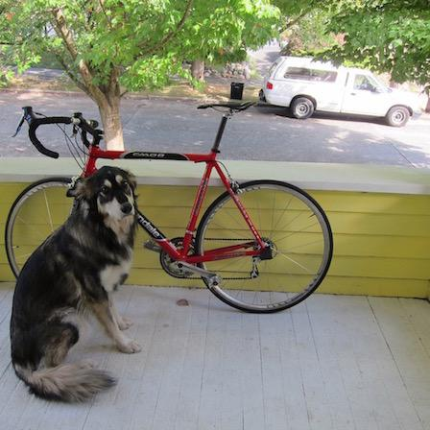
YOLO - Input
Input Image
Notes:
Maze (:25)

Slide 18
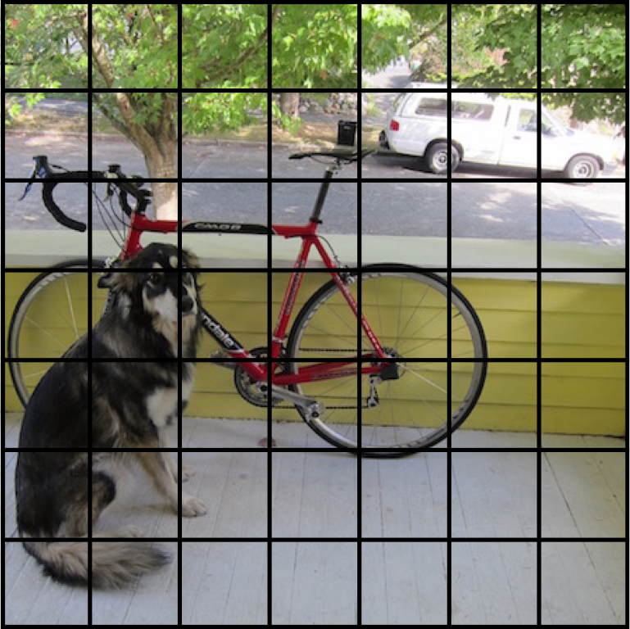
Step 1: Create a Grid
Input Image
Split the image into a grid
Notes:
Maze (:09)

Slide 19
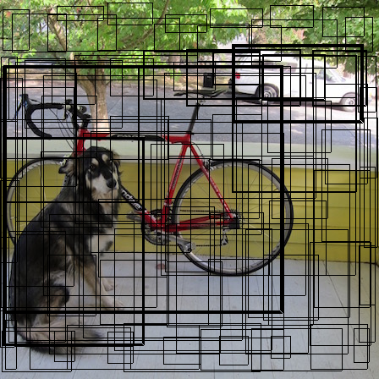
Step 2: a) Localize Objects
Input Image
Split the image into a grid
Each cell predicts boxes and confidences: P(Object)
Notes:
Maze (:24)

Slide 20
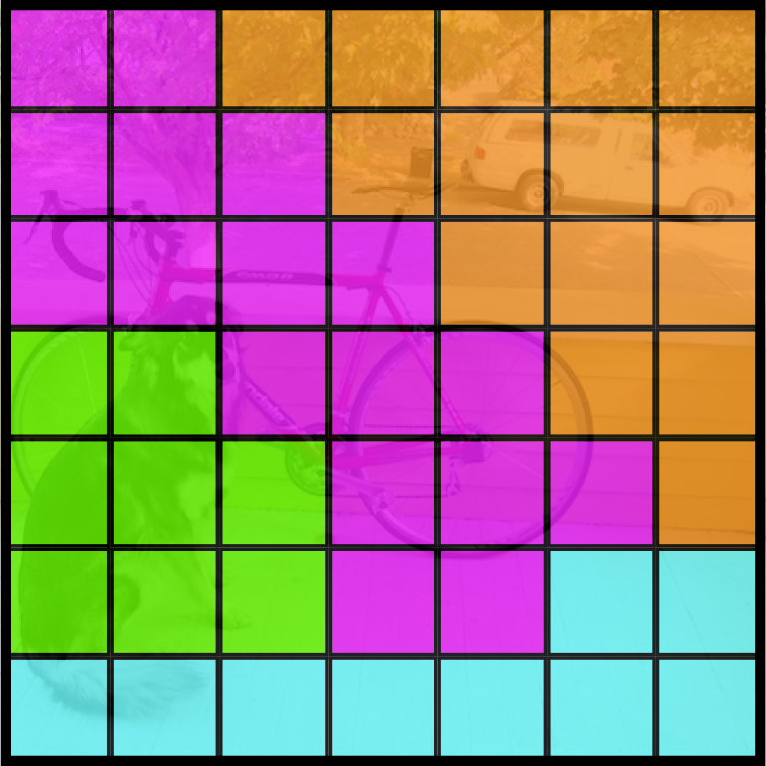
Step 2: b) Predict Objects
Input Image
Split the image into a grid
Each cell also predicts a class probability.
Car
Bicycle
Dog
Table
Notes:
Maze (:50)

Slide 21
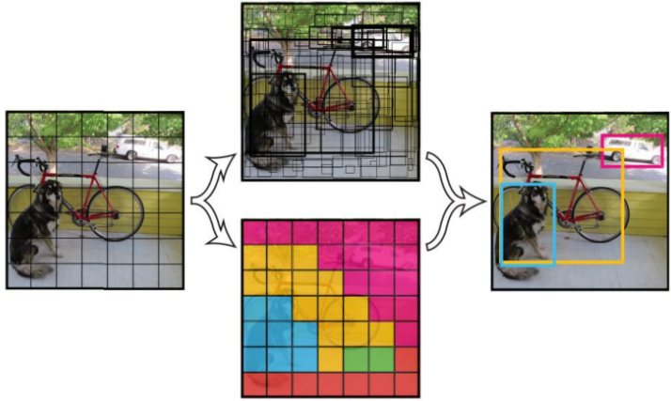
Step 3: Map Localization with Prediction
Notes:
Maze (:34)

Slide 22
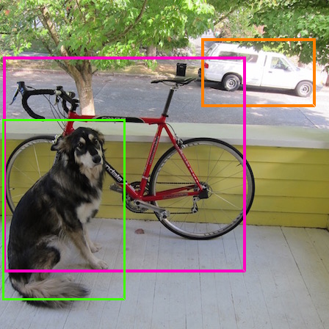
YOLO - Output
Output Image
Notes:
Maze (:29)

Slide 23
Goals

Slide 24
Gathering and Obfuscating Data
Develop program to detect pedestrians and remove data
Train the neural networks
Identify and categorize vehicles and pedestrians
Remove identifiable information
All at near real time
Storing and accessing Data
Create a database and interface
Notes:
Stephanie (:38)

Slide 25
Research Paper
Research paper on pedestrian privacy and detection
Investigate pedestrian privacy
Determine the accepted form of privacy preservation
Optimize the system
Notes:
Stephanie (:51)

Slide 26
Where we are
Notes:
Maze (RECORD)

Slide 27
Overview
We have set up:
CARLA - a simulation tool that will be used for generating training datasets
MS COCO – a large labeled dataset that will be used for training the real-time object detection algorithm
200K images
80 Distinguished Categories
500K objects annotated
YOLO – a real-time object detection algorithm
PyTorch
Works on Images and Videos
Notes:
Maze (:42)

Slide 28
CARLA
What is CARLA?
Dataset generation for autonomous driving
Free segmenting and labeling
Makes our job easier
Fixing cameras
Segmentation and labeling issues
Pedestrian and vehicle pathing
Notes:
Ian (1:26)

Slide 29
YOLOv3 Test
Test on two sources
Each source contains 16 images from surveillance cameras
Each image is updated every 30mins or so
We have collected and tested on 2,100 images
Notes:
Maze (:49)

Slide 30
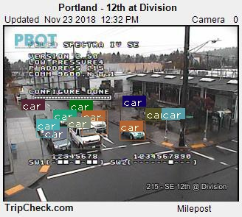
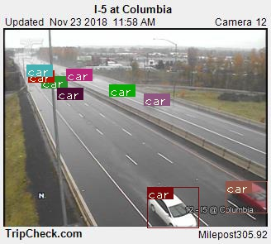
Detection - GOOD
Notes:
Maze (:12)

Slide 31
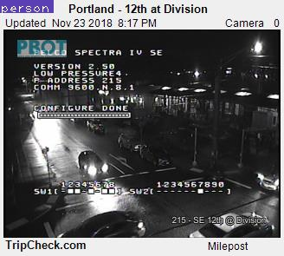
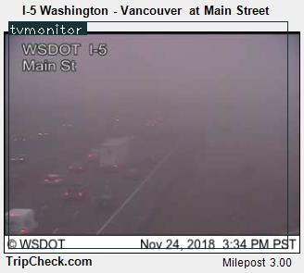
Detection - BAD
Notes:
Maze (:08)

Slide 32
Problems
Notes:
Maze (RECORD)

Slide 33
General Datasets
Obstacles determining best dataset
Form of dataset investigation and issues - video feed, images/dataset, simulation
Video feed
Poor footage quality
Images/dataset
Individual labelling
Time intensity
Simulation
CARLA, OSU server installation
Notes:
Stephanie (:55)

Slide 34
Goal Issues
Smart City PDX Initiative
200 sensors owned by General Electrics, Intel, and AT&T
Traffic Cameras
328x295 resolution (bad)
Updates once every three minutes

Slide 35
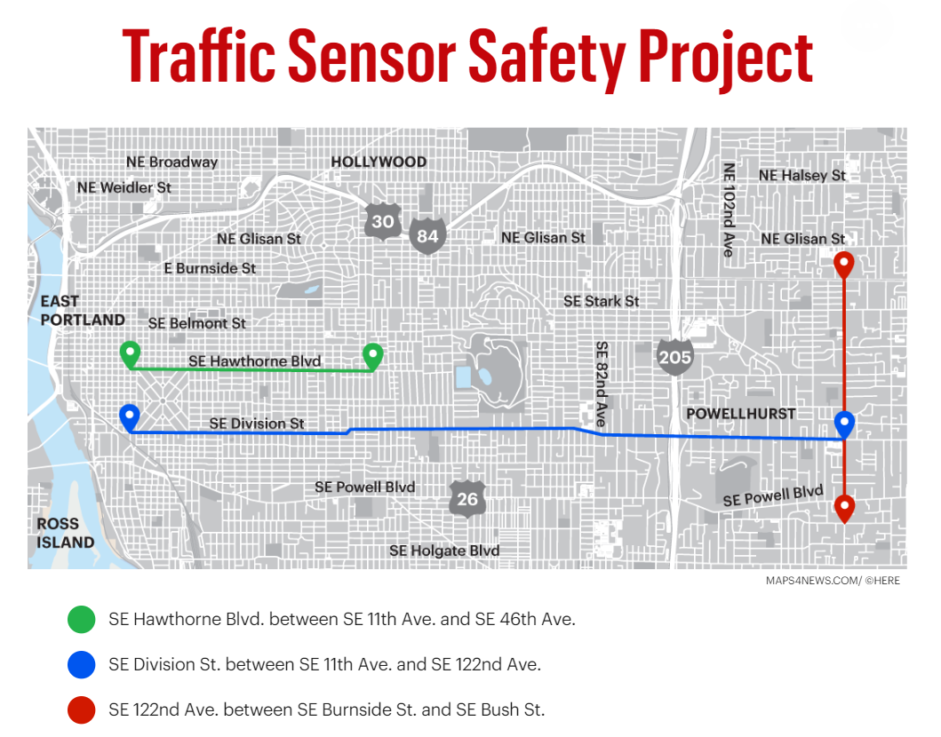

Slide 36
Goal Issues
City of Portland Project
Vehicle detection given public traffic cam footage
Pedestrian Counting and Privacy Preservation
Real-time pedestrian and vehicle detection
Personal information obfuscated
Potential extension of City of Portland project scope

Slide 37
Solutions

Slide 38
General Datasets
Determined selection criteria to relieve problem
Accuracy, Ease of Use, and Labor Intensity - Pass/Fail
Compare/contrast datasets, consulting mentors
Video feed - fragmented, low quality
Accuracy: Fail, Ease of Use: Fail, Labor Intensity: Fail
Images/dataset - individual labelling
Accuracy: Pass, Ease of Use: Fail, Labor Intensity: Fail
Simulation - pre-labelled people with CARLA
Accuracy: Pass, Ease of Use: Pass, Labor Intensity: Pass
Simulation passed criteria, chosen for project
Notes:
Stephanie (1:29)

Slide 39
CARLA
By and large, issues will be fixed in patches
Developers say that the next patch should fix the issues
Timescale
May act as a blocker to progress on the project
Other solutions may be needed
Notes:
Ian (1:00)

Slide 40
Conclusion
Project aim: To aid City of Portland in increasing pedestrian safety
Project goals:
Detect pedestrians through object and face detection,
Obscure pedestrians’ identities
Perform data analysis
Allow for greater safety & privacy for the people of Portland
Notes:
Stephanie (:56)

Slide 41
Retrospective
Notes:
Maze (RECORD)

Slide 42
Weeks 1-5
Resume building and Project selection
Source Control and Program flow
Github
Kanban
Trello
Introduction of client
Dr. Fuxin Li
Chanho Kim

Slide 43
Weeks 6 - 9
Datasets
COCO and CARLA
CARLA Issues
YOLO implemented in Pytorch
We ran it on a series of videos and images
Pulled Images from ODOT pages for analysis
Some images had great identification while others didn’t
Notes:
Ian (1:51)

Slide 44
Next Steps

Slide 45
Timeline
Timeline
Alpha Release
1.0 Release
2/11/2019
5/14/2019
Winter Term |  |  |  | Spring Term
Beta Release
3/18/2019
Notes:
Miles (:15)

Slide 46
Thank you!

